Slide 1

The Technology Value Stream
Understanding Lead Time, Processing Time, and Deployment Efficiency
CSD 380
Adrian Marquez

Slide 2
Introduction to the Technology Value Stream
Definition: A sequence of activities that transforms a business hypothesis into a digitally enabled solution delivering customer value.
Importance: Helps organizations identify bottlenecks and improve software delivery processes.

Slide 3
Lead Time vs. Processing Time
Lead Time: Total time from the start of a request to its fulfillment, including waiting periods.
Processing Time: Actual time spent actively working on a task, excluding waiting time.
Example: If a request is made on Monday and delivered on Friday, with actual work taking 2 days, the lead time is 5 days, and the processing time is 2 days.

Slide 4
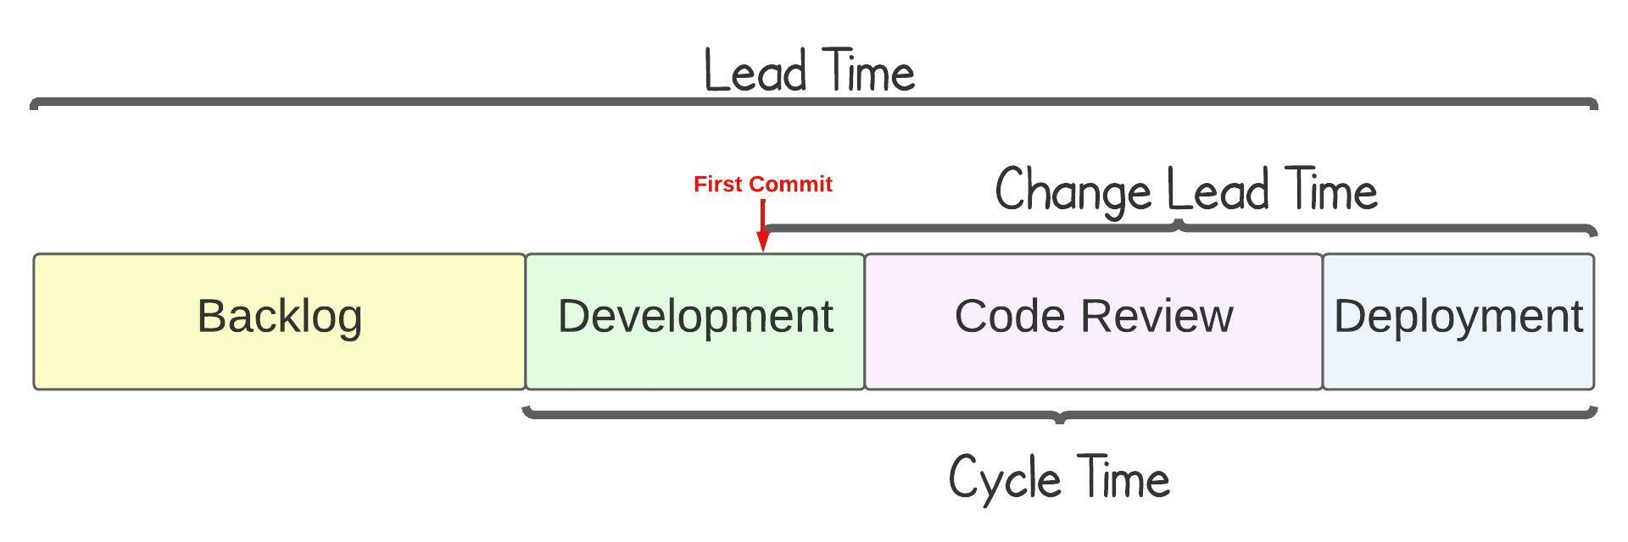

Slide 5
Common Scenario – Deployment Lead Times Requiring Months
Challenges:
Manual processes and handoffs between teams.
Lengthy approval and testing phases.
Lack of automation leading to delays.
Impact: Delayed feedback, increased costs, and reduced competitiveness.

Slide 6
DevOps Ideal – Deployment Lead Times of Minutes
Strategies:
Implementing Continuous Integration/Continuous Deployment (CI/CD)
Automated testing and monitoring.
Cross-functional teams with shared responsibilities.
Benefits: Faster feedback, improved quality, and increased customer satisfaction.

Slide 7
Case Study – Transitioning to DevOps
Scenario: A company reduced deployment lead times from months to minutes by adopting DevOps practices.
Approach:
Automated deployment pipelines.
Shift-left testing strategies.
Enhanced collaboration between development and operations teams.
Outcome: Increased deployment frequency and reduced failure rates.

Slide 8
Key Takeaways
Understanding and optimizing the technology value stream is crucial for efficient software delivery.
1
Reducing lead time and processing time enhances responsiveness to customer needs.
2
Adopting DevOps practices can transform deployment processes, leading to significant business benefits.
3

Slide 9
References
Skinner, C. From Months to Minutes, Deploying with DevOps. LinkedIn. https://www.linkedin.com/pulse/from-months-minutes-deploying-devops-christopher-skinner
Software.com. Lead time and how to measure it in DevOps. https://www.software.com/devops-guides/lead-time
Atlassian. 4 Key DevOps Metrics to Know. https://www.atlassian.com/devops/frameworks/devops-metrics

